Slide 1
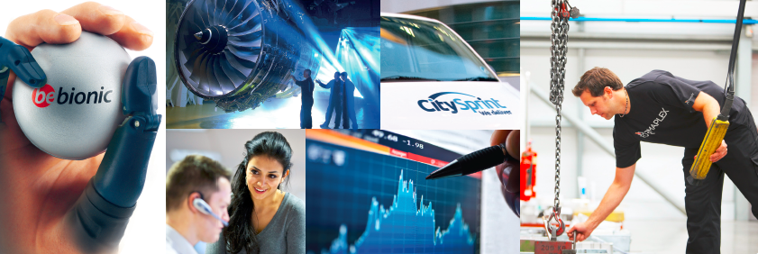
Dunedin Enterprise Investment Trust PLC
General Meeting – October 2013, Voting Analysis

Slide 2
Dunedin Enterprise Investment Trust PLC Special Resolution Proposal in respect of the Company making market purchases on the terms set out in the circular to shareholders dated 24 September 2013.
 | Votes | %
Votes For | 13,742,640 | 97.9
Votes Against | 292,489 | 2.1
Total Votes | 14,035,129 | 100.0
Withheld Votes | 86,995

Slide 3
Dunedin Enterprise
This presentation is being distributed in the United Kingdom (i) in accordance with Article 43 and/or Article 69 of the Financial Services and Markets Act 2000 (Financial Promotions) Order 2005 (the "Promotion Order") and (ii) otherwise only to such other persons to whom it may be lawful to distribute it (all such persons together being referred to as "relevant persons") under the Promotion Order. This presentation is directed only at relevant persons and must not be acted on or relied on by persons who are not relevant persons. It is intended only for the use of the persons to whom it is provided. Each recipient of this presentation is responsible for ensuring that it is kept confidential and that it is not copied or reproduced in whole or in part or given to any other person. To do so may be a criminal offence. Recipients in jurisdictions outside the United Kingdom should inform themselves about and observe any applicable legal or regulatory requirements in relation to the distribution or possession of this document to or in that jurisdiction.
This material has been prepared solely for purposes of illustration and discussion. Under no circumstances should the information contained herein be used or considered as an offer to sell, or solicitation of an offer to buy any security in Dunedin Enterprise Investment Trust PLC (the "Company") and any such offer or solicitation will only be made on the basis of a prospectus and other associated documents required by law. Neither this presentation nor anything contained in it shall form the basis for any contract or commitment whatsoever. The information is in summary form for convenience of presentation, it is not complete and it should not be relied upon as such.
All information, including performance information, has been prepared in good faith; however, neither the Company nor the Company's manager, Dunedin LLP ("Dunedin") makes any representation or warranty express or implied, as to the accuracy or completeness of the information, and nothing herein shall be relied upon as a promise or representation as to past or future performance. Past performance is not a guide to future performance and specifically there can be no assurances that an investment in the Company will have a return on invested capital similar to the historical returns on other funds managed by the Company’s manager. The material included in this presentation may include information that is based, in part or in full, on hypothetical assumptions, models and/or other analysis of Dunedin (which may not necessarily be described herein), no representation or warranty is made as to the reasonableness of any such assumptions, models or analysis and no liability whatsoever is accepted by Dunedin or the Company or any other person in relation thereto. The information set forth herein was gathered from various sources which Dunedin believes, but does not guarantee, to be reliable. Unless stated otherwise, any opinions expressed herein are current as of the date hereof and are subject to change at any time.
This presentation is issued by Dunedin on behalf of the Company. Dunedin is a limited liability partnership authorised and regulated by the Financial Conduct Authority.

Slide 4
Dunedin Enterprise Investment Trust PLC
General Meeting – October 2013, Voting Analysis

