Slide 1
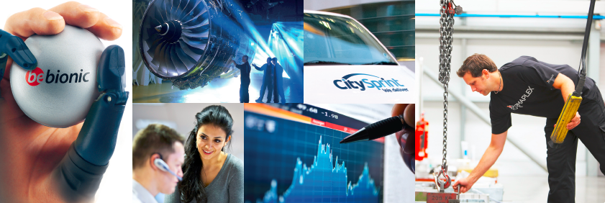
Dunedin Enterprise Investment Trust PLC
Results of General Meeting, 8 November 2012

Slide 2
Dunedin Enterprise Investment Trust PLC Resolution 1: To authorise the Company to buy back shares pursuant to the tender offer for up to 5 per cent. of the issued ordinary shares on the terms set out in the circular to shareholders of the Company dated 16 October 2012
 | Votes | %
Votes For | 18,531,550 | 98.93%
Votes Against | 200,746 | 1.07%
Total Votes | 18,732,296 | 100%

Slide 3
Dunedin Enterprise Investment Trust PLC Resolution 2: To authorise the new performance fee arrangements to be entered into with Dunedin LLP, on the terms set out in the circular to shareholders of the Company dated 16 October 2012
 | Votes | %
Votes For | 15,359,207 | 83.41%
Votes Against | 3,055,087 | 16.59%
Total Votes | 18,414,294 | 100%

